Slide 1

STM32 Dist.
Micro104

Slide 2

Analog peripherals
4
DAC (4.1)
DAC wave generation lab (4.1.1)
ADC (4.2)
ADC Poll lab (4.2.1)
ADC Interrupt lab (4.2.2)
ADC DMA lab (4.2.3)

Slide 3
4.1.1 DAC wave generator lab

Slide 4
Use DAC as wave generator
4.1.1
Objective
Learn how to setup DAC as wave generator in CubeMX
How to Generate Code in CubeMX and use HAL functions
Goal
Configure DAC as wave generator in CubeMX and Generate Code
Learn how start it in project

Slide 5
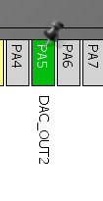
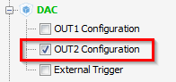
Use DAC as wave generator
4.1.1
Create project in CubeMX
Menu > File > New Project
Select STM32F4 > STM32F429/439 > LQFP144 > STM32F439ZITx
CubeMX DAC selection
Select DAC OUT2

Slide 6
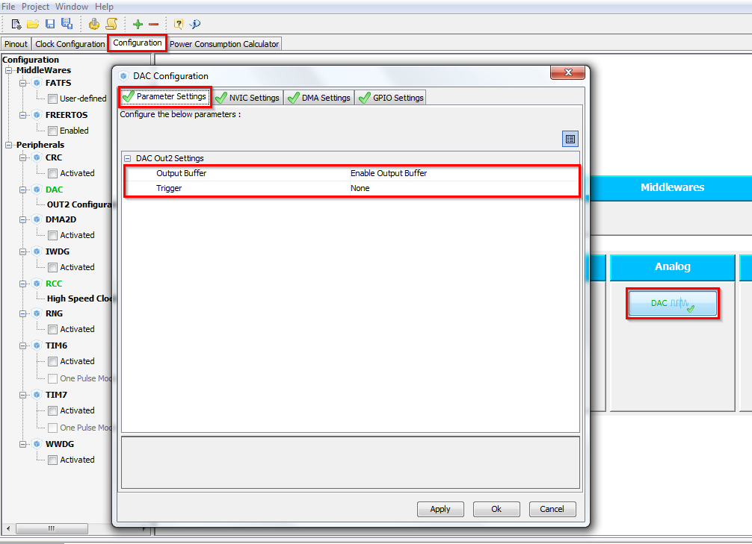
Use DAC as wave generator
4.1.1
CubeMX DAC configuration
TAB>Configuration>Analog>DAC>Parametr Settings
Enable Output buffer
Button OK

Slide 7
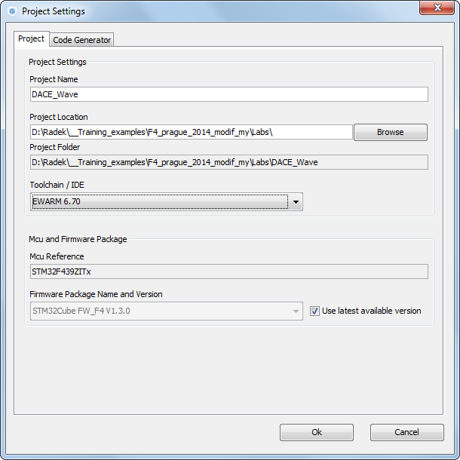
Use DAC as wave generator
4.1.1
Now we set the project details for generation
Menu > Project > Project Settings
Set the project name
Project location
Type of toolchain
Now we can Generate Code
Menu > Project > Generate Code

Slide 8
Use DAC as wave generator
4.1.1
Start process DAC generation (same for DMA, ADC)
Non blocking start process
Peripheral Initializations
Start Process
HAL_DAC_Start
Set value
HAL_DAC_SetValue

Slide 9
Use DAC as wave generator
4.1.1
Open the project in our IDE
The functions we want to put into main.c
Between /* USER CODE BEGIN 2 */ and /* USER CODE END 2 */ tags
and /* USER CODE BEGIN 3 */ and /* USER CODE END 3 */ tags
For DAC start use function
HAL_DAC_Start(DAC_HandleTypeDef* hdac, uint32_t Channel)
DAC set DAC value
HAL_DAC_SetValue(DAC_HandleTypeDef* hdac, uint32_t Channel, uint32_t Alignment, uint32_t Data)

Slide 10
CubeMX and OpenSTM32

Slide 11
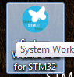
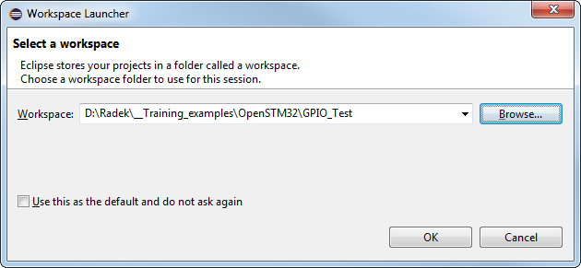
Open new Nucleo project
Open SW4STM32 (System workbench for STM32)
Select the workspace path
I select location of my project generated by CubeMX
But it depends on personal preference and Eclipse knowledge

Slide 12
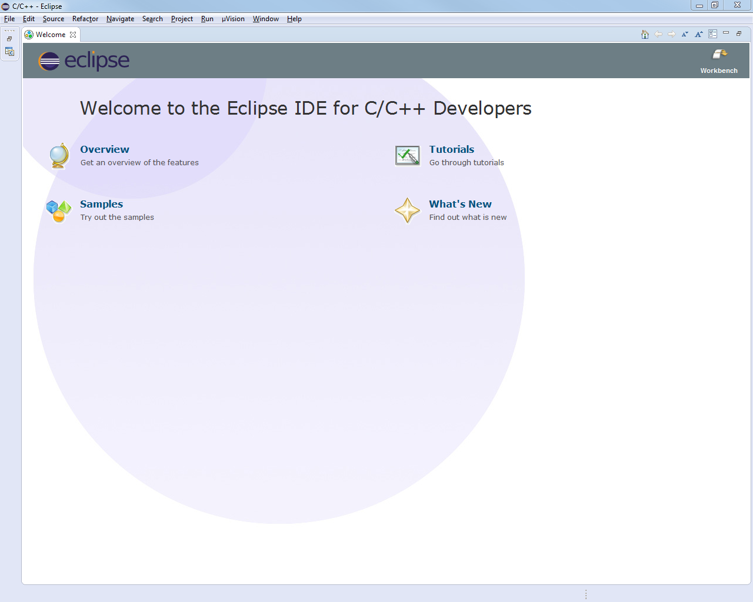
Eclipse start
Close the welcome panel
Then the Project explorer and code browser window will be maximized

Slide 13
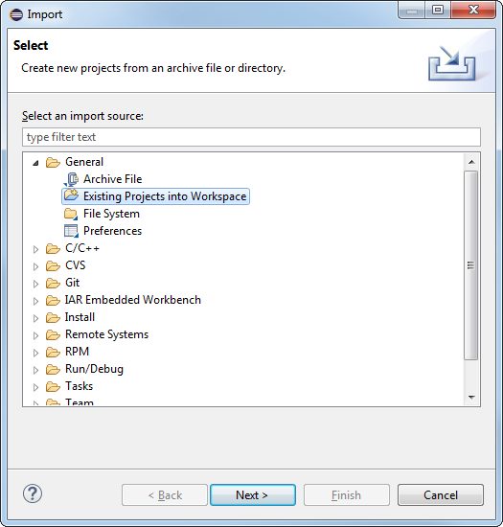
Eclipse Import project 1
Menu>File>Import…
Select Existing Project into Workspace
Next

Slide 14
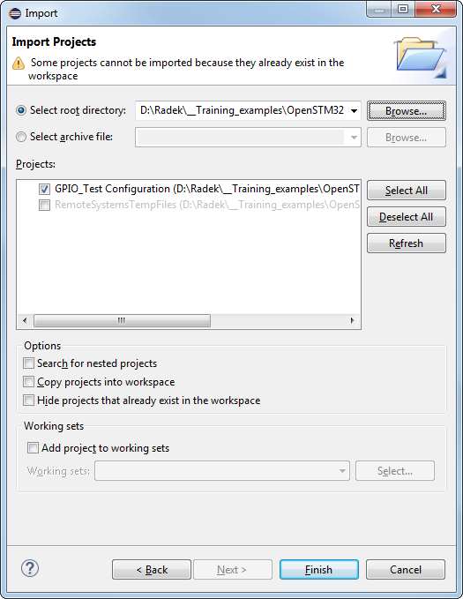
Eclipse Import project 2
Use Select root directory
Browse for directory position
In my case I search for GPIO_Test directory
IDE warns us that directory is already in workspace (ignore)
Next

Slide 15
Use DAC as wave generator
4.1.1
Solution
DAC setup and start
Create the wave
/* USER CODE BEGIN 2 */
HAL_DAC_Start(&hdac,DAC_CHANNEL_2);
/* USER CODE END 2 */
/* USER CODE BEGIN 3 */
/* Infinite loop */
while (1)
{
HAL_DAC_SetValue(&hdac, DAC_CHANNEL_2, DAC_ALIGN_12B_R, value_dac);
value_dac++;
if(value_dac>4095)
{
value_dac=0;
}
HAL_Delay(1);
}
/* USER CODE END 3 */

Slide 16
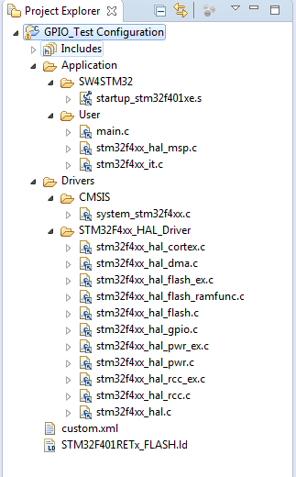
Eclipse Modify project
Now CubeMX project is in our workspace
/* USER CODE BEGIN 2 */
HAL_DAC_Start(&hdac,DAC_CHANNEL_2);
/* USER CODE END 2 */
/* Infinite loop */
/* USER CODE BEGIN WHILE */
while (1)
{
/* USER CODE END WHILE */
/* USER CODE BEGIN 3 */
while (1)
{
HAL_DAC_SetValue(&hdac, DAC_CHANNEL_2, DAC_ALIGN_12B_R, value_dac);
value_dac++;
if(value_dac>4095)
{
value_dac=0;
}
HAL_Delay(1); }
/* USER CODE END 3 */

Slide 17
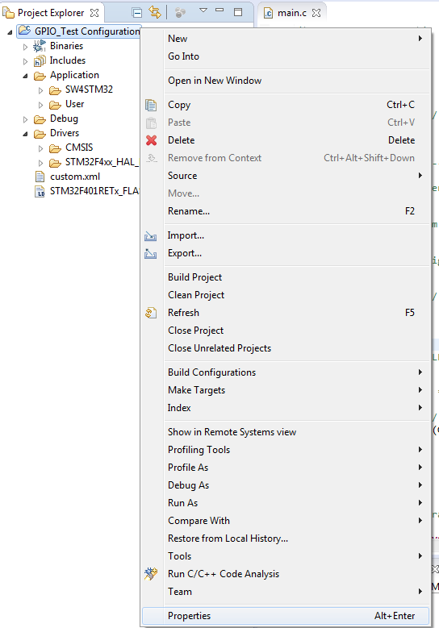
Eclipse project configuration
Right click on Project>Properties or ALT+ENTER

Slide 18
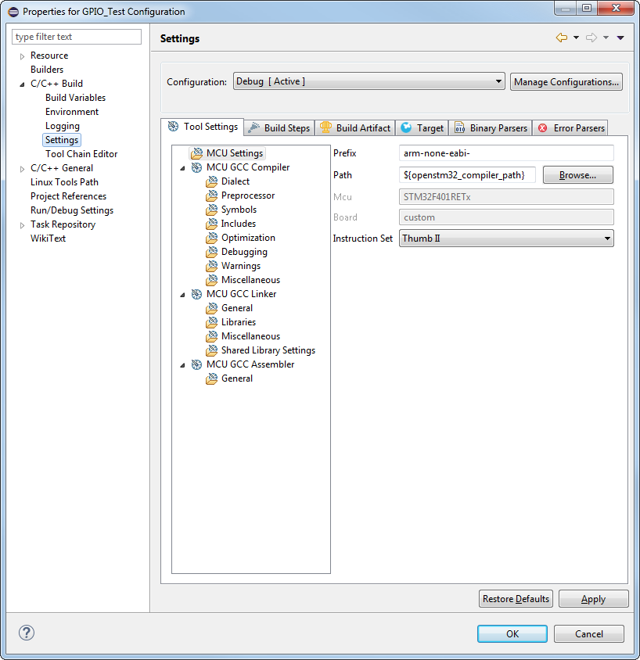
Eclipse project settings
In “C/C++ Build”
You can find “Settings”
Here is settings of your project like in Keil (includes, optimization and others)

Slide 19
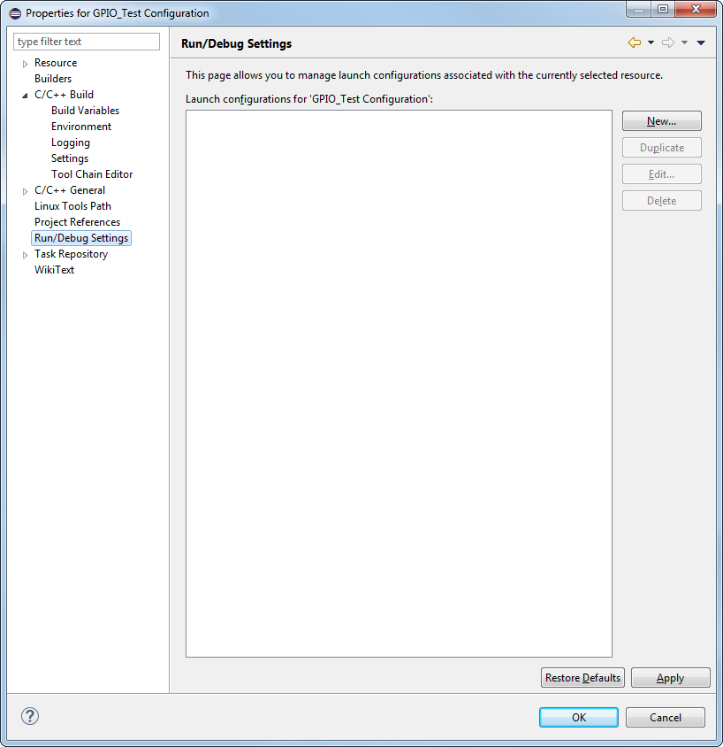
Eclipse debug configuration 1
Go to “Run/Debug settings”
Click “New…”

Slide 20
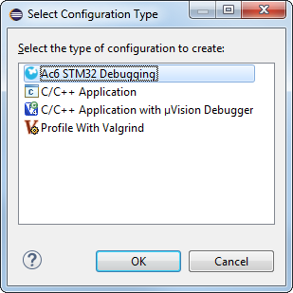
Eclipse debug configuration 2
Select “Ac6 STM32 Debugging”
Press “OK” Button

Slide 21
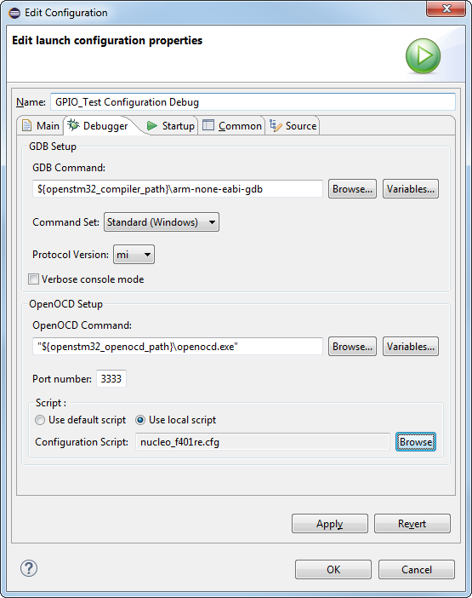
Eclipse debug configuration 3
Select Debbuger tab
Select Use local script
Search for *.cfg script
Usual path is
XXX\Ac6\SystemWorkbench \plugins \fr.ac6.mcu.debug_1.0.0.xxxxxxxxx \resources\openocd\scripts\st_board
Click on “Apply” and “OK”

Slide 22
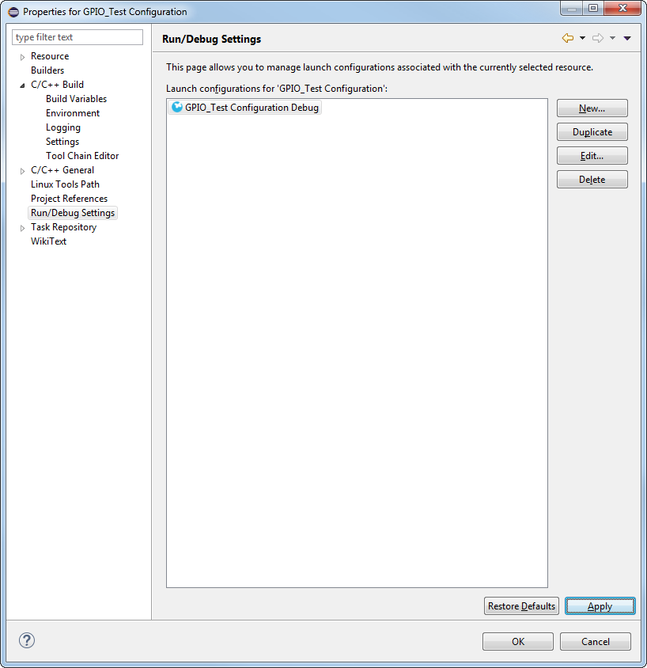
Eclipse debug configuration 4
Click on “Apply” and “OK”

Slide 23
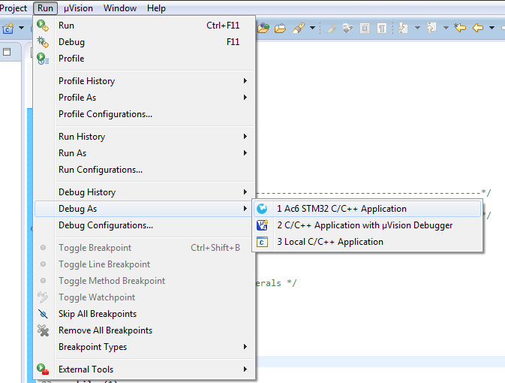
Eclipse Run debug
Menu Run>Debug As> Ac6 STM32 C/C++ Application

Slide 24
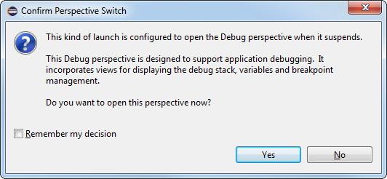
Eclipse Run debug
The compilation starts
If everything is OK, IDE offers you to switch to Debug perspective
Click “Yes” (possibly check “Remember my decision” before)

Slide 25
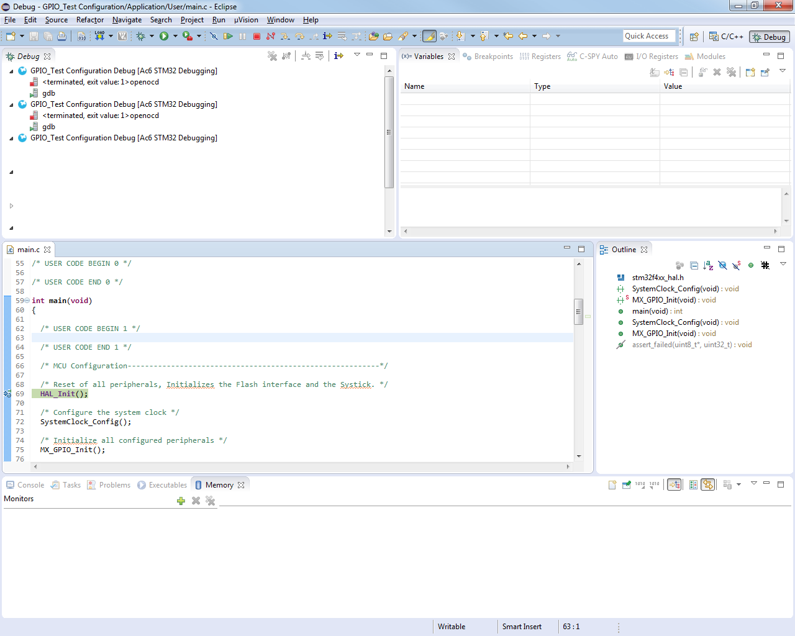
Eclipse Run debug
Enjoy debug!

Slide 26
Eclipse Run debug
To leave debug
Click red square
Change back perspective to editor

Slide 27
Eclipse debug for different board
If you want to debug different board you must create own *.cfg file
It is important to change the ST-Link type
And the work size
# This is an ST NUCLEO F401RE board with a single STM32F401RET6 chip.
# http://www.st.com/web/catalog/tools/FM116/SC959/SS1532/LN1847/PF260000
source [find interface/stlink-v2-1.cfg]
set WORKAREASIZE 0x10000
source [find target/stm32f4x_stlink.cfg]
# use hardware reset, connect under reset
reset_config srst_only srst_nogate

Slide 28
4.2.1 ADC Poll lab

Slide 29
Use ADC in polling mode
4.2.1
Objective
Use the DAC part from previous lab
Learn how to setup ADC in CubeMX
How to Generate Code in CubeMX and use HAL functions
Goal
Configure ADC in poll in CubeMX and Generate Code
Learn how to start ADC and measure the DAC
Verify the measured wave in STMStudio (http://www.st.com/web/en/catalog/tools/PF251373 require JAVA)

Slide 30
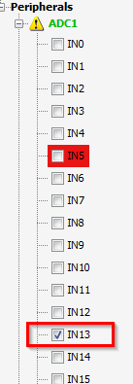
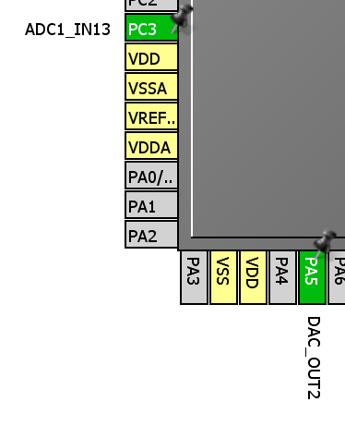
Use ADC in polling mode
4.2.1
Create project in CubeMX
Menu > File > New Project
Select STM32F4 > STM32F429/439 > LQFP144 > STM32F439ZITx
CubeMX DAC selection
Select DAC OUT2
Select ADC IN13

Slide 31
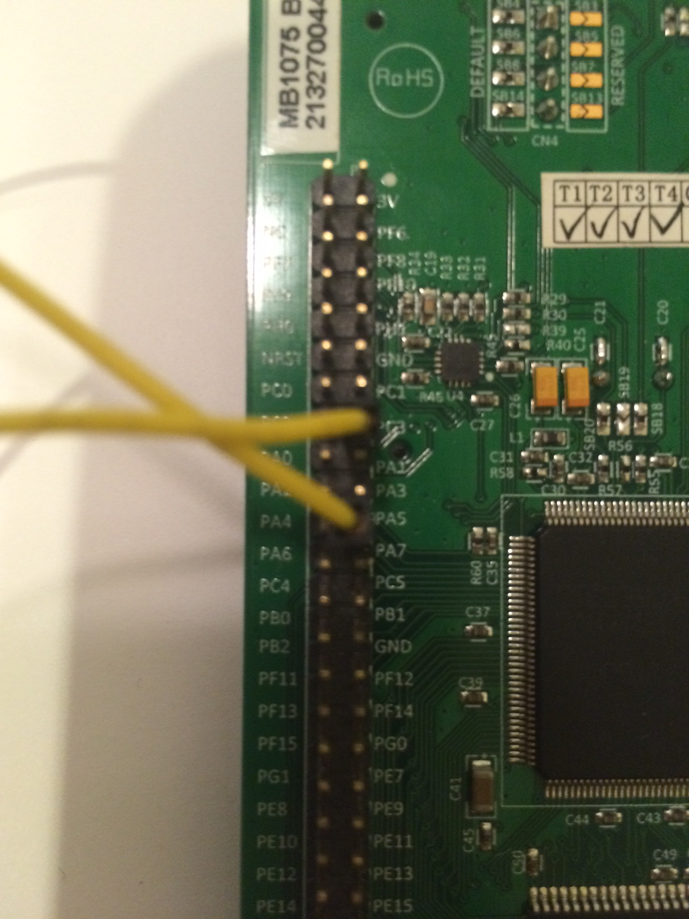
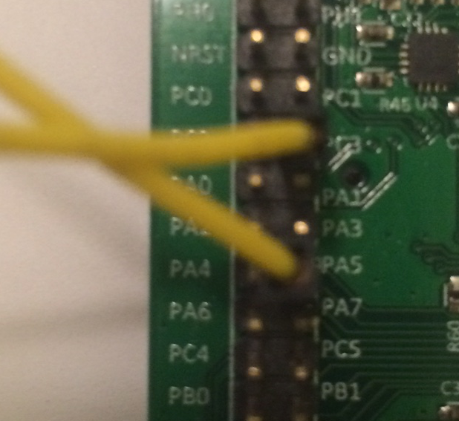
Use ADC in polling mode
4.2.1
Hardware connection
Connect DAC out2 PA5 and ADC1 IN13 PC3 together

Slide 32
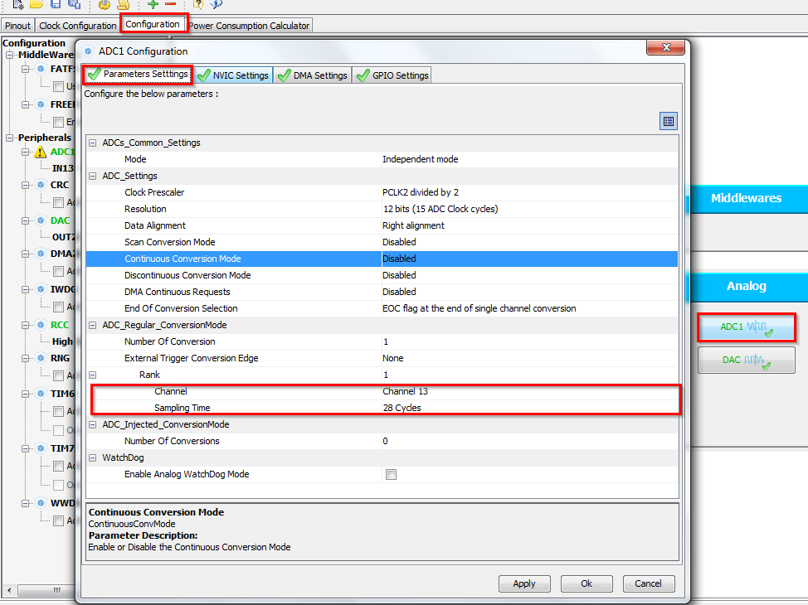
Use ADC in polling mode
4.2.1
CubeMX ADC configuration
TAB>Configuration>Analog>ADC1>Parametr Settings
Set ADC1
Set sampling time for CH13
Button OK
DAC from previous example

Slide 33
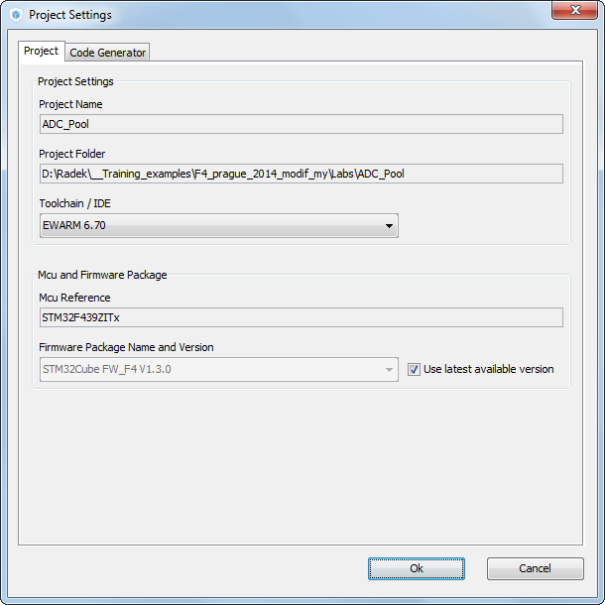
Use ADC in polling mode
4.2.1
Now we set the project details for generation
Menu > Project > Project Settings
Set the project name
Project location
Type of toolchain
Now we can Generate Code
Menu > Project > Generate Code

Slide 34
Use ADC in polling mode
4.2.1
Start process ADC(same for DMA, DAC, TIM)
Non blocking start process
Peripheral Initializations
Start Process
HAL_DAC_Start
Peripheral Initializations
Start Process
HAL_DAC_Start

Slide 35
Use ADC in polling mode
4.2.1
Open the project in our IDE
The functions we want to put into main.c
Between /* USER CODE BEGIN 2 */ and /* USER CODE END 2 */ tags
and /* USER CODE BEGIN 3 */ and /* USER CODE END 3 */ tags
For DAC start use function
HAL_DAC_Start(DAC_HandleTypeDef* hdac, uint32_t Channel)
HAL_ADC_PollForConversion(ADC_HandleTypeDef* hadc, uint32_t Timeout)
HAL_ADC_GetValue(ADC_HandleTypeDef* hadc)
DAC functions
HAL_DAC_Start(DAC_HandleTypeDef* hdac, uint32_t Channel)
HAL_DAC_SetValue(DAC_HandleTypeDef* hdac, uint32_t Channel, uint32_t Alignment, uint32_t Data)

Slide 36
Use ADC in polling mode
4.2.1
Solution
Variables
DAC setup and start
/* USER CODE BEGIN PV */
uint32_t value_adc;
uint32_t value_dac=0;
/* USER CODE END PV */
/* USER CODE BEGIN 2 */
HAL_DAC_Start(&hdac,DAC_CHANNEL_2);
HAL_DAC_SetValue(&hdac, DAC_CHANNEL_2, DAC_ALIGN_12B_R, value_dac);
/* USER CODE END 2 */

Slide 37
Use ADC in polling mode
4.2.1
Solution
Main loop with DAC set and ADC set
/* USER CODE BEGIN 3 */
/* Infinite loop */
while (1)
{
HAL_ADC_Start(&hadc1);
HAL_ADC_PollForConversion(&hadc1,10);
value_adc=HAL_ADC_GetValue(&hadc1);
HAL_DAC_SetValue(&hdac, DAC_CHANNEL_2, DAC_ALIGN_12B_R, value_dac);
value_dac++;
if(value_dac>4095){
value_dac=0;
}
HAL_Delay(1);
}
/* USER CODE END 3 */

Slide 38
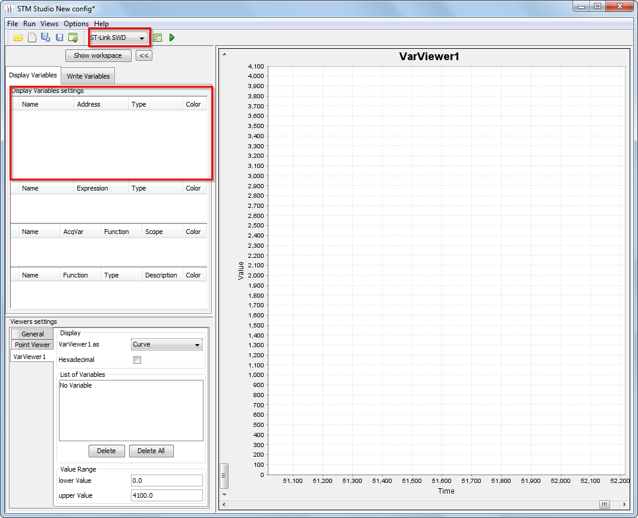
Use ADC in polling mode
4.2.1
Test the functionality
We need the address of variable value_adc
This can be found usually in debug mode in watch, my address is 0x2000005C (depends on compilator and optimizations)
Start the STMStudio
Set the ST Link SWD
Right click into Display variable settings
Select NEW

Slide 39
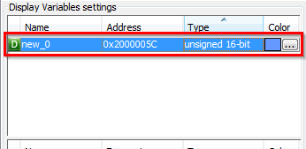
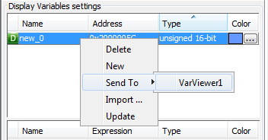
Use ADC in polling mode
4.2.1
STM studio settings
Set value_adc address my 0x2000005C
Set 16bit unsigned val
Right click on this line
Select Send To VarViewer1

Slide 40
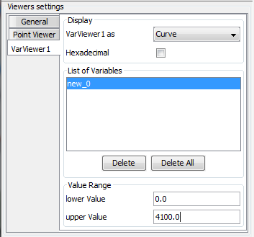
Use ADC in polling mode
4.2.1
STM studio settings
Viewers settings is on bottom
Set the correct upper value to 4096(12bit)

Slide 41
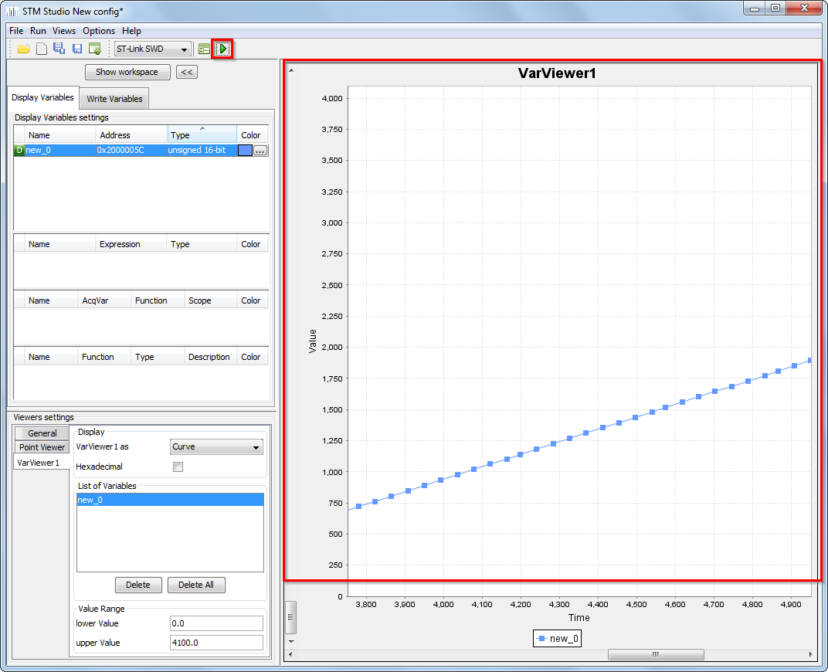
Use ADC in polling mode
4.2.1
STM studio settings
Now press green play button
And you will see content of value_adc

Slide 42
4.2.2 ADC Interrupt lab

Slide 43
Use ADC with interrupt
4.2.2
Objective
Use the DAC part from previous lab
Learn how to setup ADC with interrupt in CubeMX
How to Generate Code in CubeMX and use HAL functions
Goal
Configure ADC in interrupt in CubeMX and Generate Code
Learn how to start ADC and measure the DAC
Verify the measured wave in STMStudio (http://www.st.com/web/en/catalog/tools/PF251373 require JAVA)

Slide 44
Use ADC with interrupt
4.2.2
Create project in CubeMX
Menu > File > New Project
Select STM32F4 > STM32F429/439 > LQFP144 > STM32F439ZITx
CubeMX DAC selection
Select DAC OUT2
Select ADC IN13

Slide 45
Use ADC with interrupt
4.2.2
CubeMX ADC configuration
TAB>Configuration>Analog>ADC1>Parametr Settings
Set ADC1
Set sampling time for CH13
Button OK
DAC from previous example

Slide 46
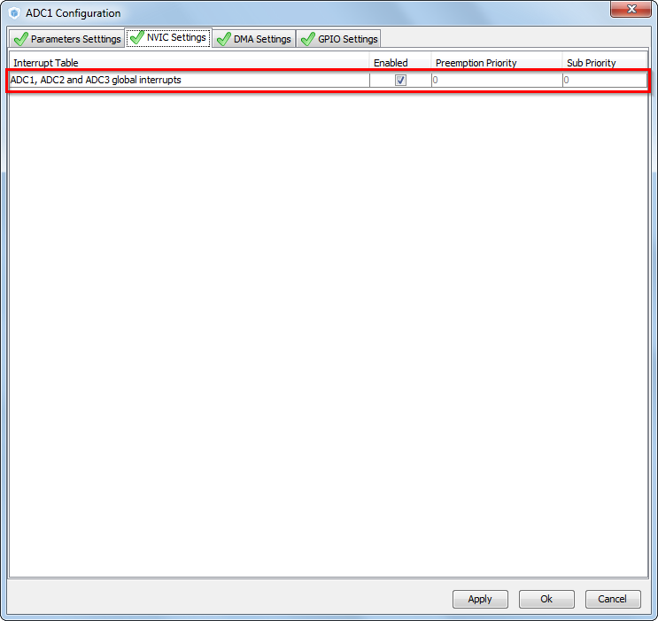
Use ADC with interrupt
4.2.2
CubeMX ADC configuration
TAB>NVIC settings
Enable ADC1 interrupt
Button OK

Slide 47
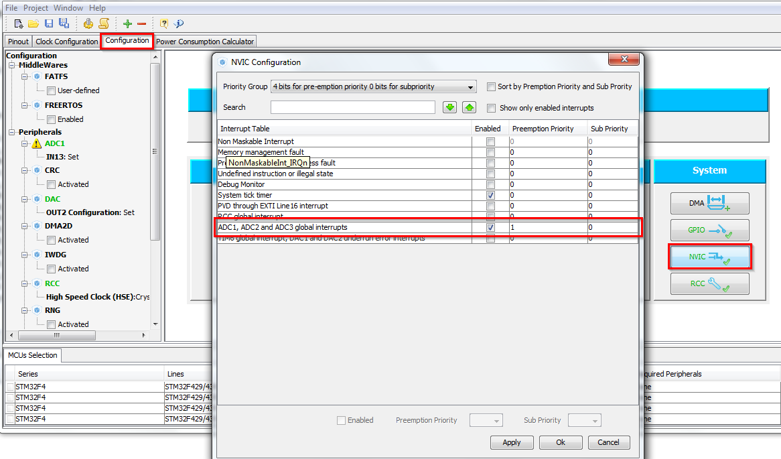
Use ADC with interrupt
4.2.2
CubeMX NVIC configuration
Because we want use the Systick for delay in interrupt The ADC interrupt priority must be changed
TAB>Configuration>System>NVIC
Change ADC1 preemption priority to 1

Slide 48

Use ADC with interrupt
4.2.2
Now we set the project details for generation
Menu > Project > Project Settings
Set the project name
Project location
Type of toolchain
Now we can Generate Code
Menu > Project > Generate Code

Slide 49
Use ADC with interrupt
4.2.2
HAL Library ADC with IT flow
ADCInitializations
including peripheral interrupt NVIC initializations
Start process with interrupt generation at end of process
HAL_ADC_Start_IT
HAL_OK
HAL_ERROR
HAL_ADC_IRQHandler
ADC_IRQHandler
HAL_BUSY
process callback
HAL_ADC_ConvCpltCallback
process Error callback
HAL_ADC_ErrorCallback

Slide 50
Use ADC with interrupt
4.2.2
Open the project in our IDE
The functions we want to put into main.c
Between /* USER CODE BEGIN 2 */ and /* USER CODE END 2 */ tags
and /* USER CODE BEGIN 4 */ and /* USER CODE END 4 */ tags
For DAC start use function
HAL_ADC_Start_IT(ADC_HandleTypeDef* hadc, uint32_t Channel)
HAL_ADC_GetValue(ADC_HandleTypeDef* hadc)
ADC complete callback function
HAL_ADC_ConvCpltCallback(ADC_HandleTypeDef* hadc)
DAC functions
HAL_DAC_Start(DAC_HandleTypeDef* hdac, uint32_t Channel)
HAL_DAC_SetValue(DAC_HandleTypeDef* hdac, uint32_t Channel, uint32_t Alignment, uint32_t Data)

Slide 51
Use ADC with interrupt
4.2.2
Solution
Variables
DAC setup and start ADC/DAC
/* USER CODE BEGIN PV */
uint32_t value_adc;
uint32_t value_dac=0;
/* USER CODE END PV */
/* USER CODE BEGIN 2 */
HAL_DAC_Start(&hdac,DAC_CHANNEL_2);
HAL_DAC_SetValue(&hdac, DAC_CHANNEL_2, DAC_ALIGN_12B_R, value_dac);
HAL_ADC_Start_IT(&hadc1);
/* USER CODE END 2 */

Slide 52
Use ADC with interrupt
4.2.2
Solution
ADC complete callback routine
/* USER CODE BEGIN 4 */
void HAL_ADC_ConvCpltCallback(ADC_HandleTypeDef* hadc)
{
value_adc=HAL_ADC_GetValue(&hadc1);
HAL_DAC_SetValue(&hdac, DAC_CHANNEL_2, DAC_ALIGN_12B_R, value_dac);
value_dac++;
if(value_dac>4095){
value_dac=0;
}
HAL_Delay(1);
HAL_ADC_Start_IT(&hadc1);
}
/* USER CODE END 4 */

Slide 53
Use ADC with interrupt
4.2.2
STM studio settings
Check functionality again with STMstudio

Slide 54
4.2.3 ADC with DMA lab

Slide 55
Use ADC with DMA
4.2.3
Objective
Use the DAC part from previous lab
Learn how to setup ADC with DMA in CubeMX
How to Generate Code in CubeMX and use HAL functions
Goal
Configure ADC in DMA in CubeMX and Generate Code
Learn how to start ADC and measure the DAC
Verify the measured wave in STMStudio (http://www.st.com/web/en/catalog/tools/PF251373 require JAVA)

Slide 56
Use ADC with DMA
4.2.3
Create project in CubeMX
Menu > File > New Project
Select STM32F4 > STM32F429/439 > LQFP144 > STM32F439ZITx
CubeMX DAC selection
Select DAC OUT2
Select ADC IN13

Slide 57
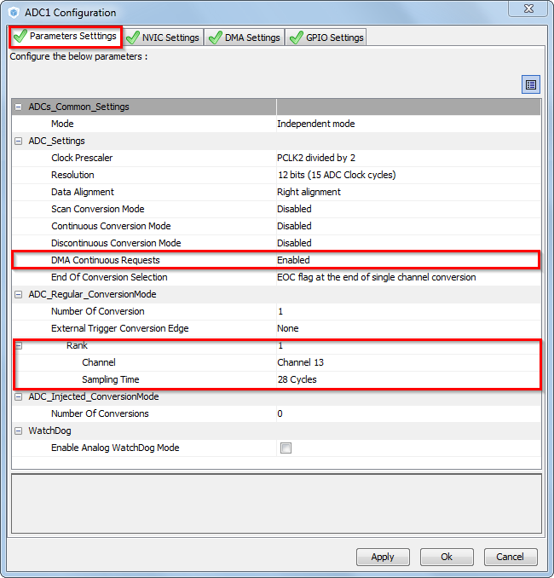
Use ADC with DMA
4.2.3
CubeMX ADC configuration
TAB>Configuration>Analog>ADC1>Parameter Settings
Set ADC1
Set sampling time for CH13
DMA Continuous requests
Button OK
DAC from previous example

Slide 58
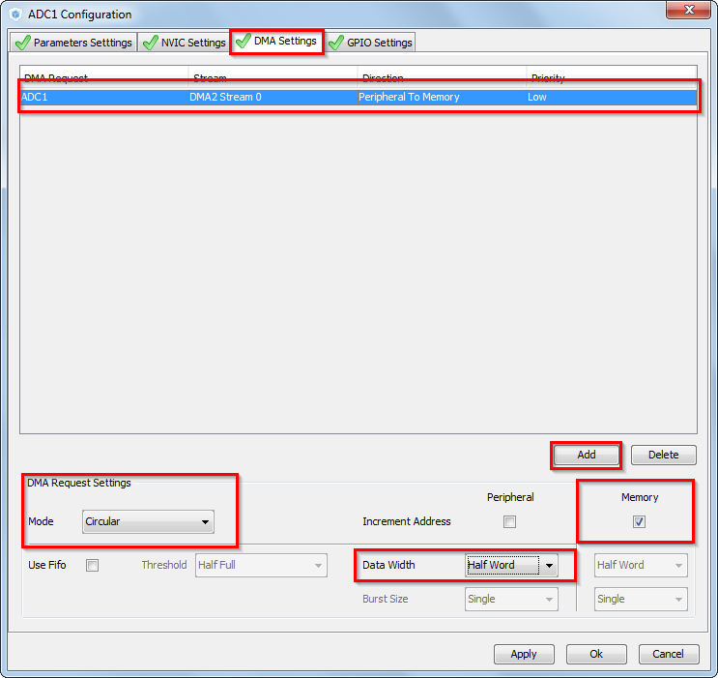
Use ADC with DMA
4.2.3
CubeMX ADC configuration
TAB>DMA Settings
Button ADD
DMA request ADC1
Peripheral to memory direction
Circular mode
Memory increment
Half word data width
Button OK

Slide 59
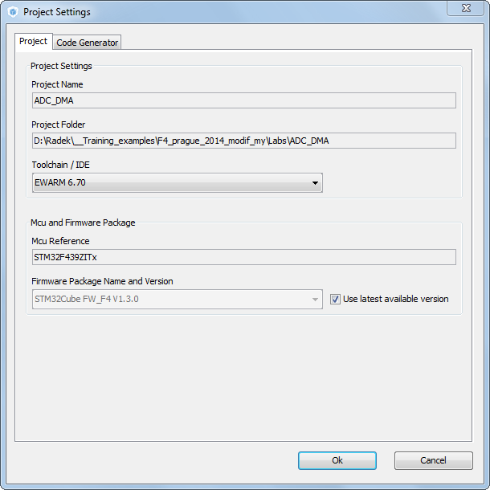
Use ADC with DMA
4.2.3
Now we set the project details for generation
Menu > Project > Project Settings
Set the project name
Project location
Type of toolchain
Now we can Generate Code
Menu > Project > Generate Code

Slide 60
Use ADC with DMA
4.2.3
HAL Library ADC with DMA flow
ADCInitializations
including peripheral interrupt NVIC initializations
Start process with interrupt generation at end of process
HAL_ADC_Start_DMA
HAL_OK
HAL_ERROR
HAL_DMA_IRQHandler
DMA1_StreamX_IRQHandler
HAL_BUSY
process callback
HAL_ADC_ConvCpltCallback
process Error callback
HAL_ADC_ErrorCallback

Slide 61
Use ADC with DMA
4.2.3
Open the project in our IDE
The functions we want to put into main.c
Between /* USER CODE BEGIN 2 */ and /* USER CODE END 2 */ tags
and /* USER CODE BEGIN 3 */ and /* USER CODE END 3 */ tags
For DAC start use function
HAL_ADC_Start_DMA(ADC_HandleTypeDef* hadc, uint32_t* pData, uint32_t Length)
DAC functions
HAL_DAC_Start(DAC_HandleTypeDef* hdac, uint32_t Channel)
HAL_DAC_SetValue(DAC_HandleTypeDef* hdac, uint32_t Channel, uint32_t Alignment, uint32_t Data)

Slide 62
Use ADC with DMA
4.2.3
Solution
Variables
DAC setup and start ADC/DAC
/* USER CODE BEGIN PV */
uint32_t value_adc;
uint32_t value_dac=0;
/* USER CODE END PV */
/* USER CODE BEGIN 2 */
HAL_DAC_Start(&hdac,DAC_CHANNEL_2);
HAL_DAC_SetValue(&hdac, DAC_CHANNEL_2, DAC_ALIGN_12B_R, value_dac);
HAL_ADC_Start_DMA(&hadc1,(uint32_t*)&value_adc,1);
/* USER CODE END 2 */

Slide 63
Use ADC with DMA
4.2.3
Solution
ADC main routine
/* USER CODE BEGIN 3 */
/* Infinite loop */
while (1)
{
HAL_DAC_SetValue(&hdac, DAC_CHANNEL_2, DAC_ALIGN_12B_R, value_dac);
value_dac++;
if(value_dac>4095){
value_dac=0;
}
HAL_Delay(5);
HAL_ADC_Start(&hadc1);
HAL_Delay(5);
}
/* USER CODE END 3 */

Slide 64
Use ADC with DMA
4.2.3
STM studio settings
Check functionality again with STMstudio

Slide 65
www.st.com/stm32

